Slide 1
Term Project
Team B.S.
B.S. Poker
Jimmy Chung
Yuning Hong
Jordan Leong
Steven Lum

Slide 2
Game Overview
-Players start with X amount of cards
-Wild cards to increase the number of combinations
-Players take turns calling a higher hand
-Call B.S. on a hand that you think does not exist
-Lose if you call B.S. falsely or was correctly called on yours
-Loser of round starts with one less card
-SUDDEN DEATH

Slide 3
WireFrames
On the next page

Slide 4
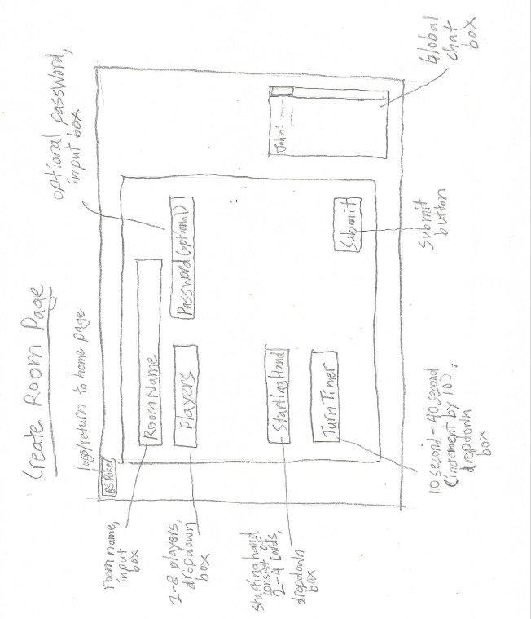

Slide 5
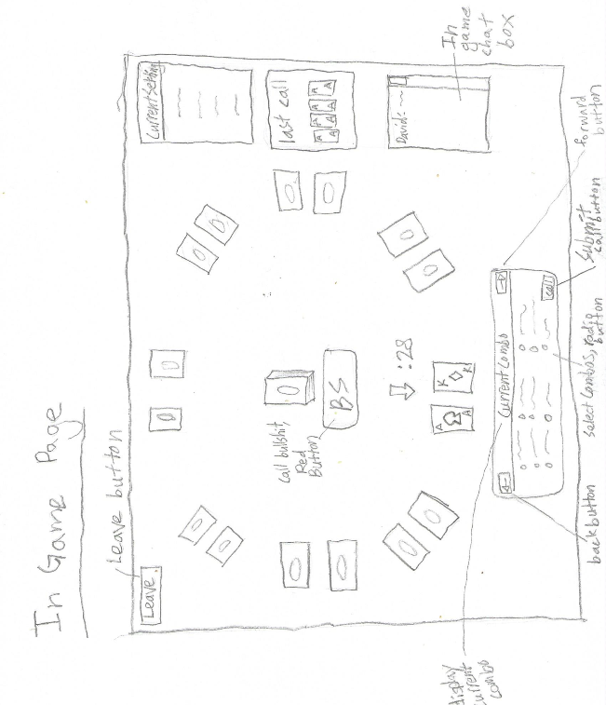

Slide 6
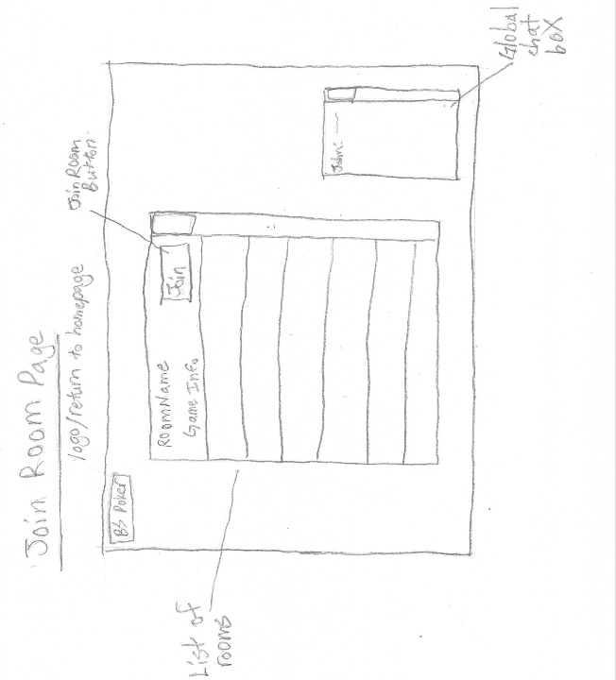

Slide 7
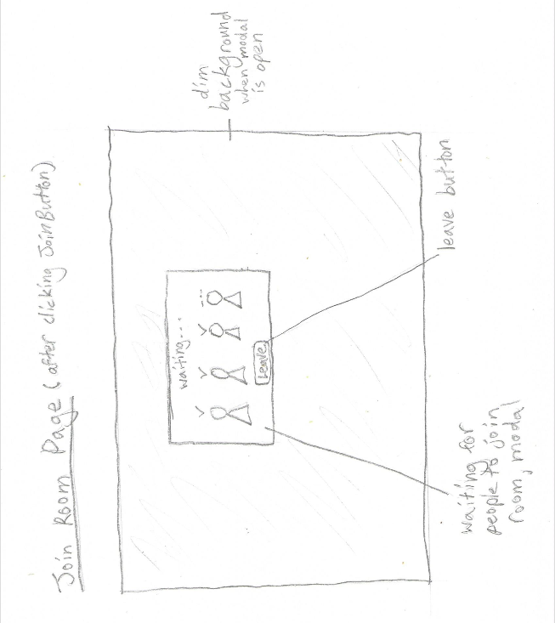

Slide 8
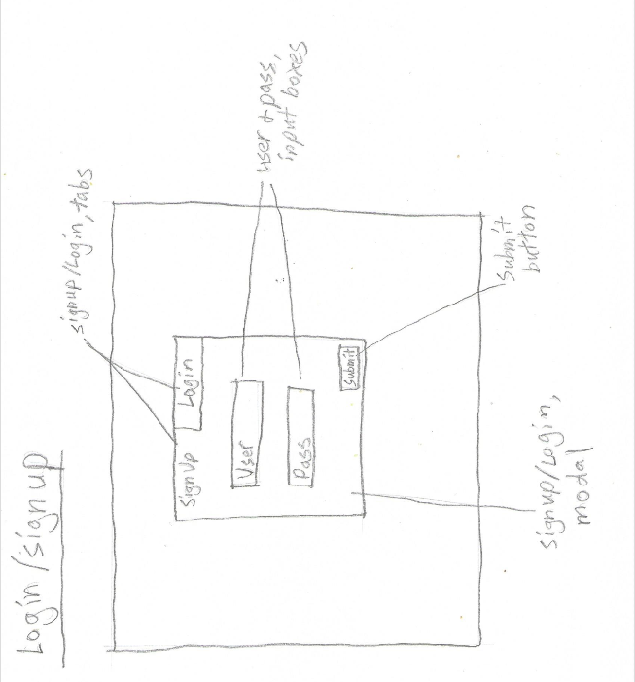

Slide 9
End of Presentation
Any Questions?

